Slide 1

JADRAN GOTTINO FOODS
High-Quality Confectionery Products and Snacks

Slide 2

Location
Negotino, Republic of Macedonia
Population of 15,000 people
Situated on the right bank of the river Vardar, about 100 km south of Skopje, Macedonia’s capital
Located in the Povardarie vineyard region
Along with Kavadarci, Negotino is the home of Macedonia’s best wine and rakija (homemade brandy)

Slide 3
History
Founded in 1956
Biggest producer in ex-Yugoslavia for traditional sweets
  Turkish delight, halva, tahini

Slide 4
Today
December 2007: new production line for filled croissants
October 15, 2009: opening of a new 2.5 million euro production unit for hard and soft biscuits and crackers
Afterwards we invested additionally in another 2 lines:
- Chocolate enrobing line
- Extrusion production line
With this we surround our first investment plan with 5 different confectionary production lines including our handcrafted product line for traditional sweets like Halva and Lokumi.
In this moment we export in more than 20 countries in Europe and across the world, including: Germany, Netherlands, Austria, Italy, Switzerland, Czech Republic, Russia, Greece, Hungary, Slovakia, Canada, USA, Australia, Libya, Iraq, Ex-YU countries, etc.
R&D department is already working on several new projects that will spread the range of our production (e.g., powdered baby food, cereals)

Slide 5
Certification
Hazard Analysis Critical Control Point (HACCP)
ISO 22000:2005 (Food safety management systems)
BRC - Standard
Human Resources Development Project (HRDP), a project financed by the European Bank for Reconstruction and Development (EBRD)

Slide 6
Current Production Lines
Traditional sweets
Long shelf life filled croissants
Hard and soft biscuits&crackers
Powdered baby food and cereals
Chocolate enrobing line
Overall capacity: 9000 tones/year

Slide 7
Private Label Production
More than 10 private label product articles at the moment
  Metro Cash&Carry; DIS Markets; (Serbia)
  Kam Markets,
  Tesco, Fresh (Slovakia)
  Tiwist (Turkey)
  Etc.

Slide 8
Own Brand Production
Gottino Foods as an umbrella brand
Jadran; Pick’n Joy; Sun Grain; BUONO
65 product articles
  85 product articles overall by the end of 2015
  New line for production of mini filled croissants and strudels.

Slide 9

High-Quality Confectionery Products and Snacks

Slide 10
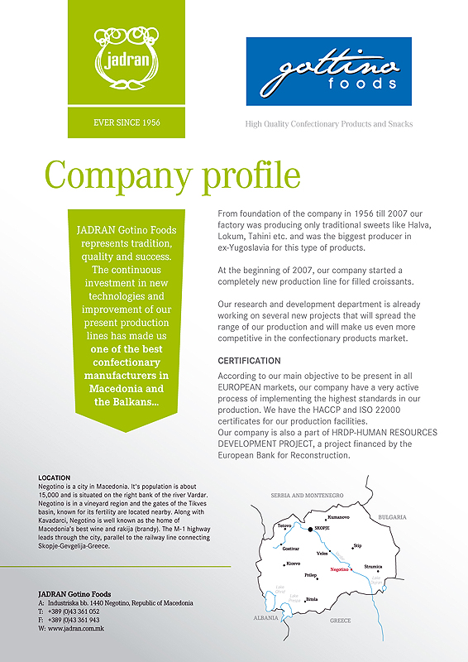

Slide 11
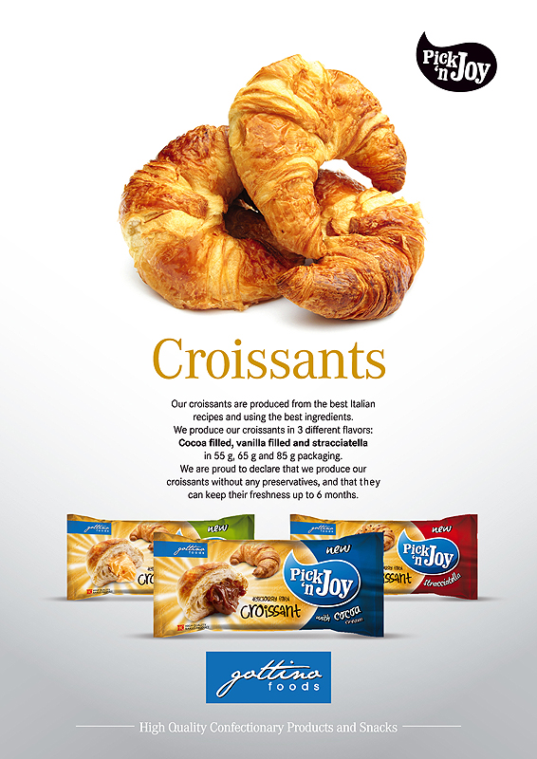

Slide 12
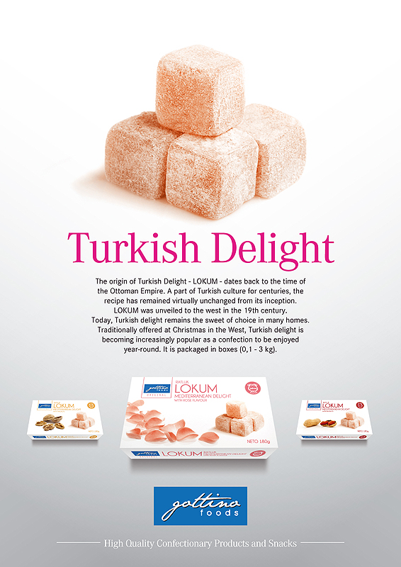

Slide 13
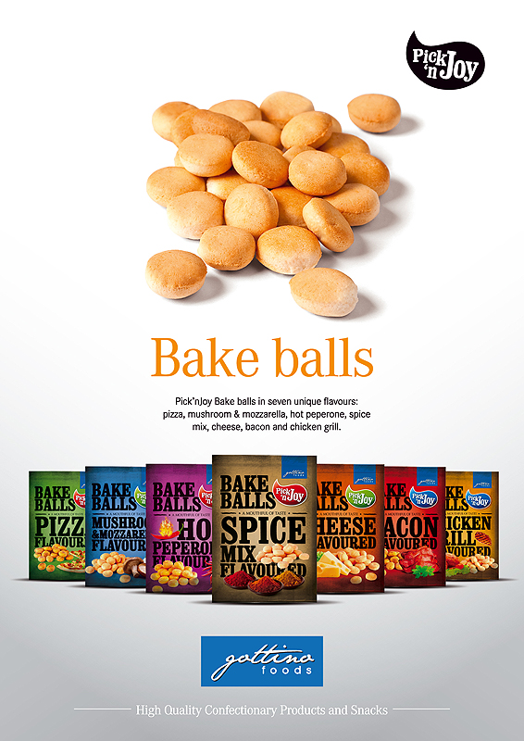

Slide 14
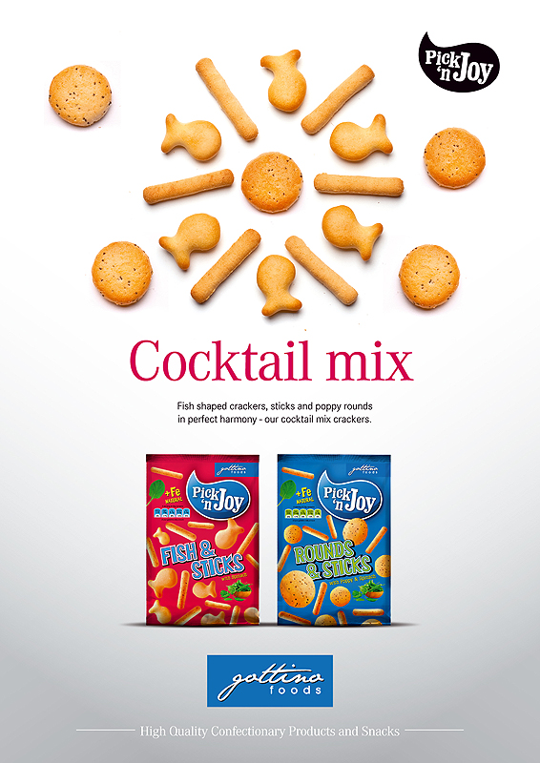

Slide 15
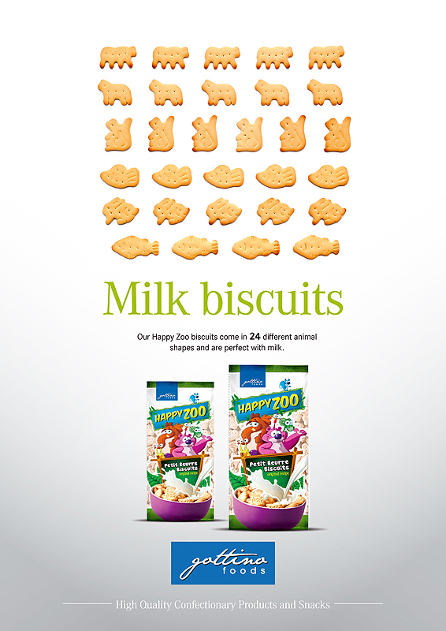

Slide 16


Slide 17


Slide 18
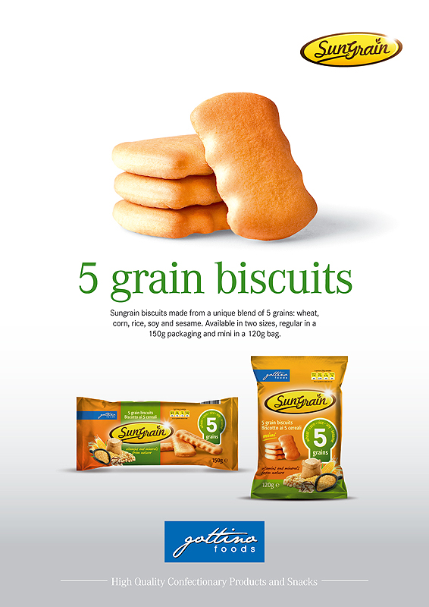

Slide 19
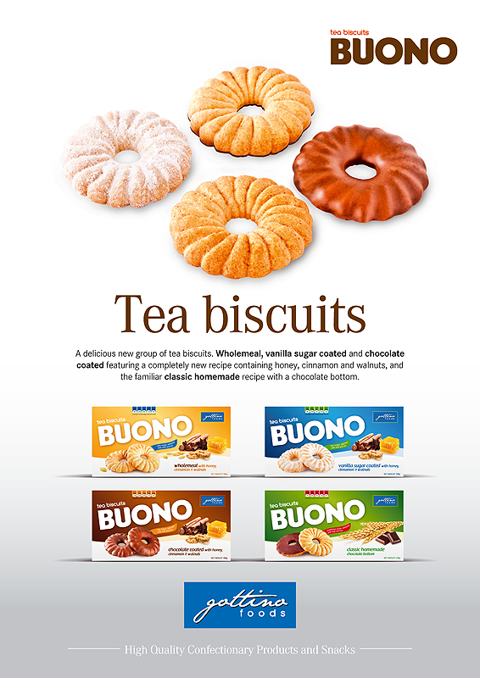

Slide 20
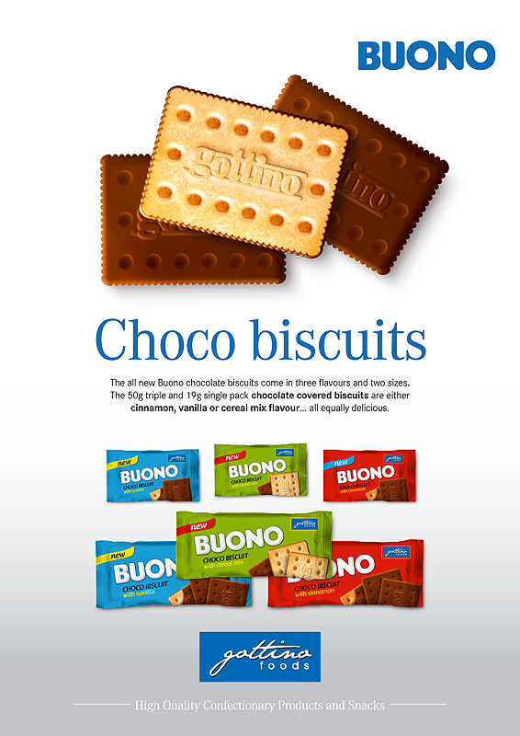

Slide 21
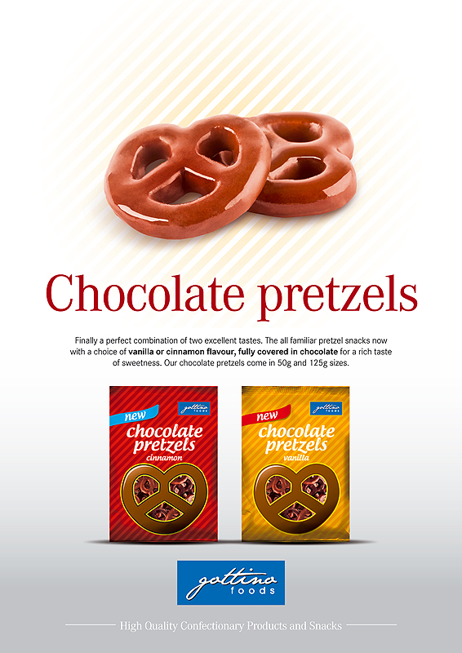

Slide 22
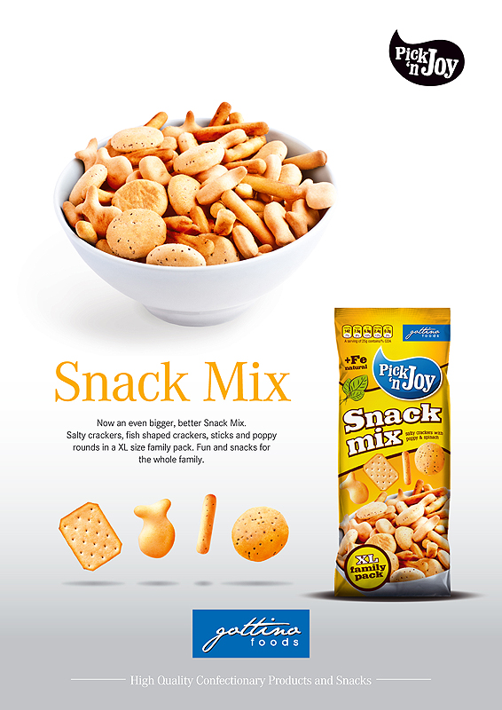

Slide 23
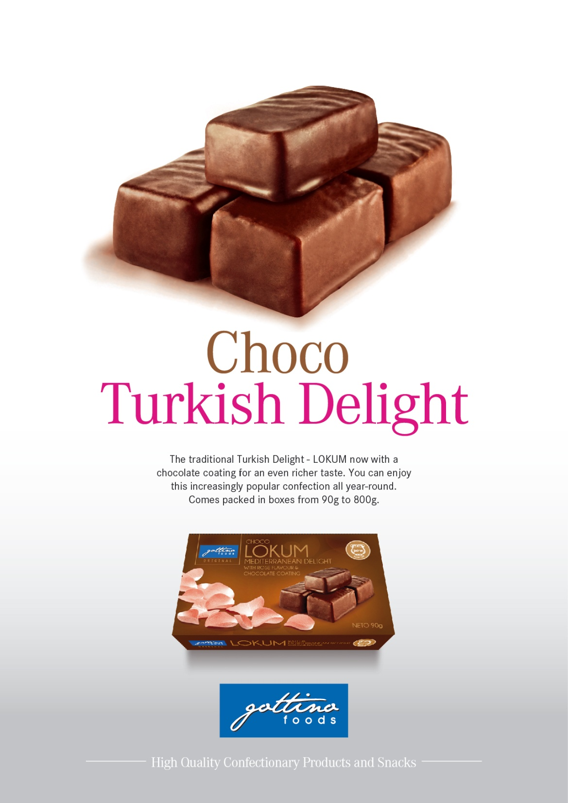

Slide 24
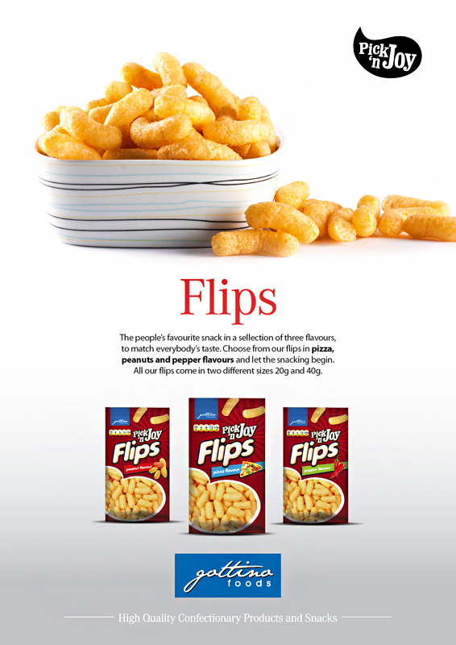

Slide 25
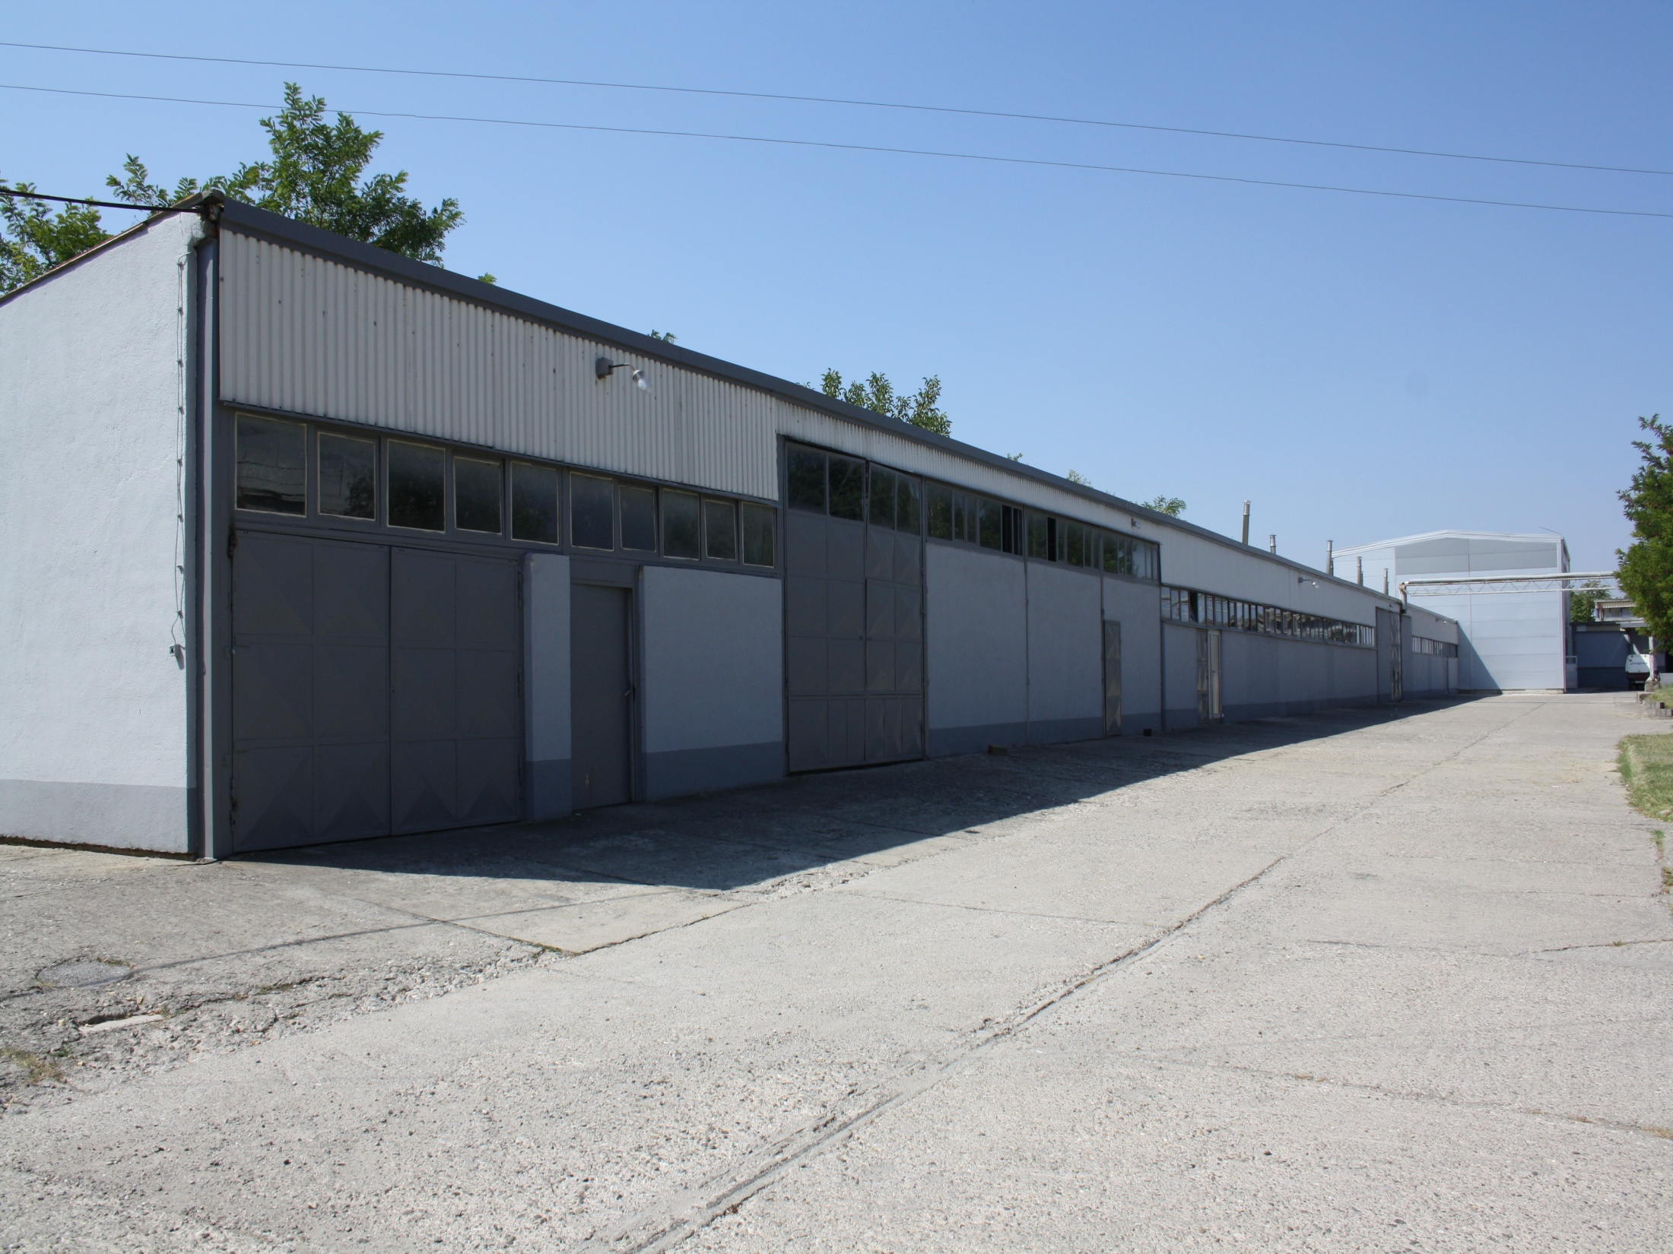

Slide 26
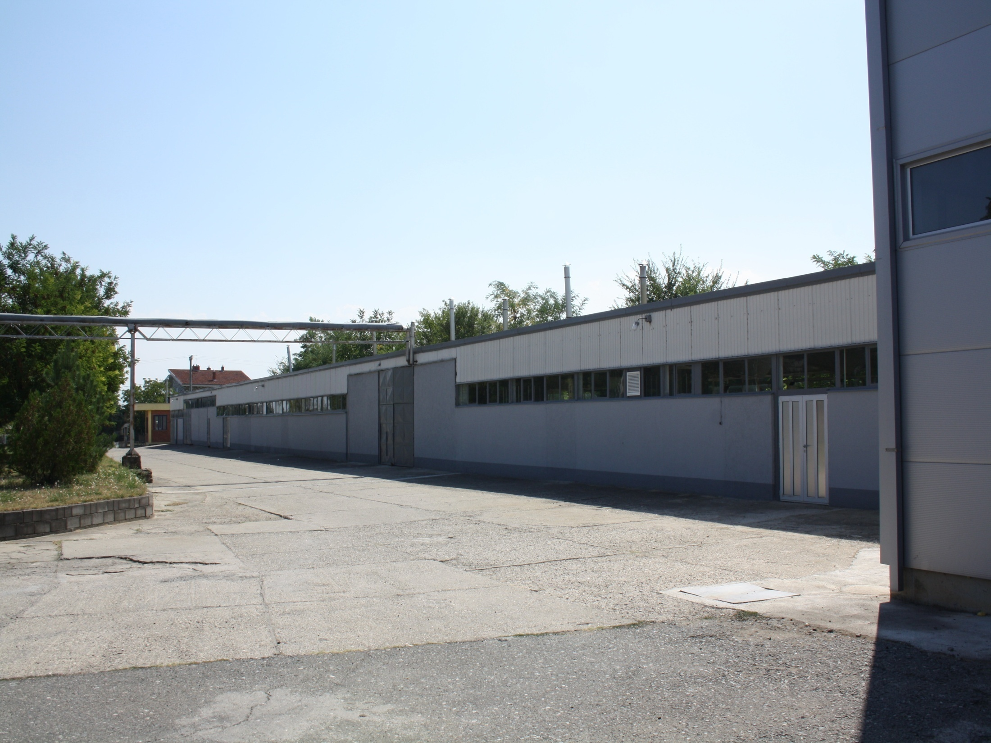

Slide 27


Slide 28
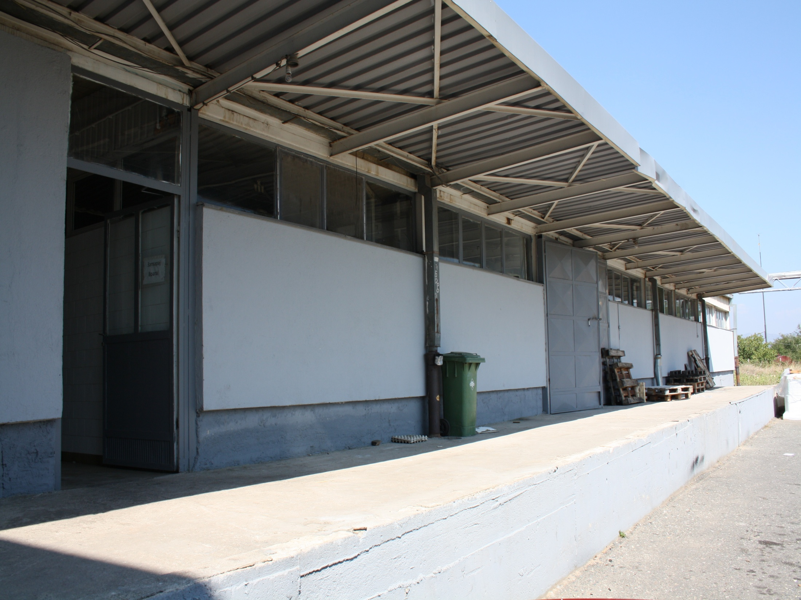

Slide 29
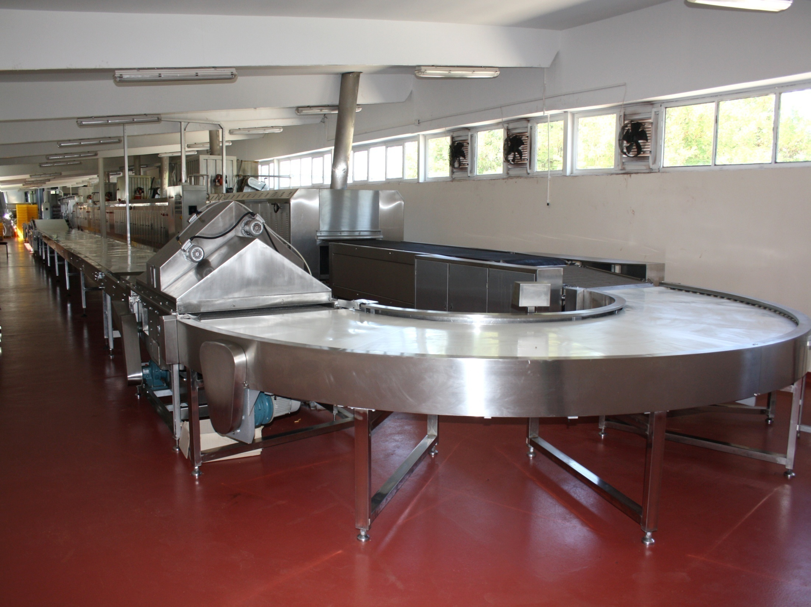

Slide 30
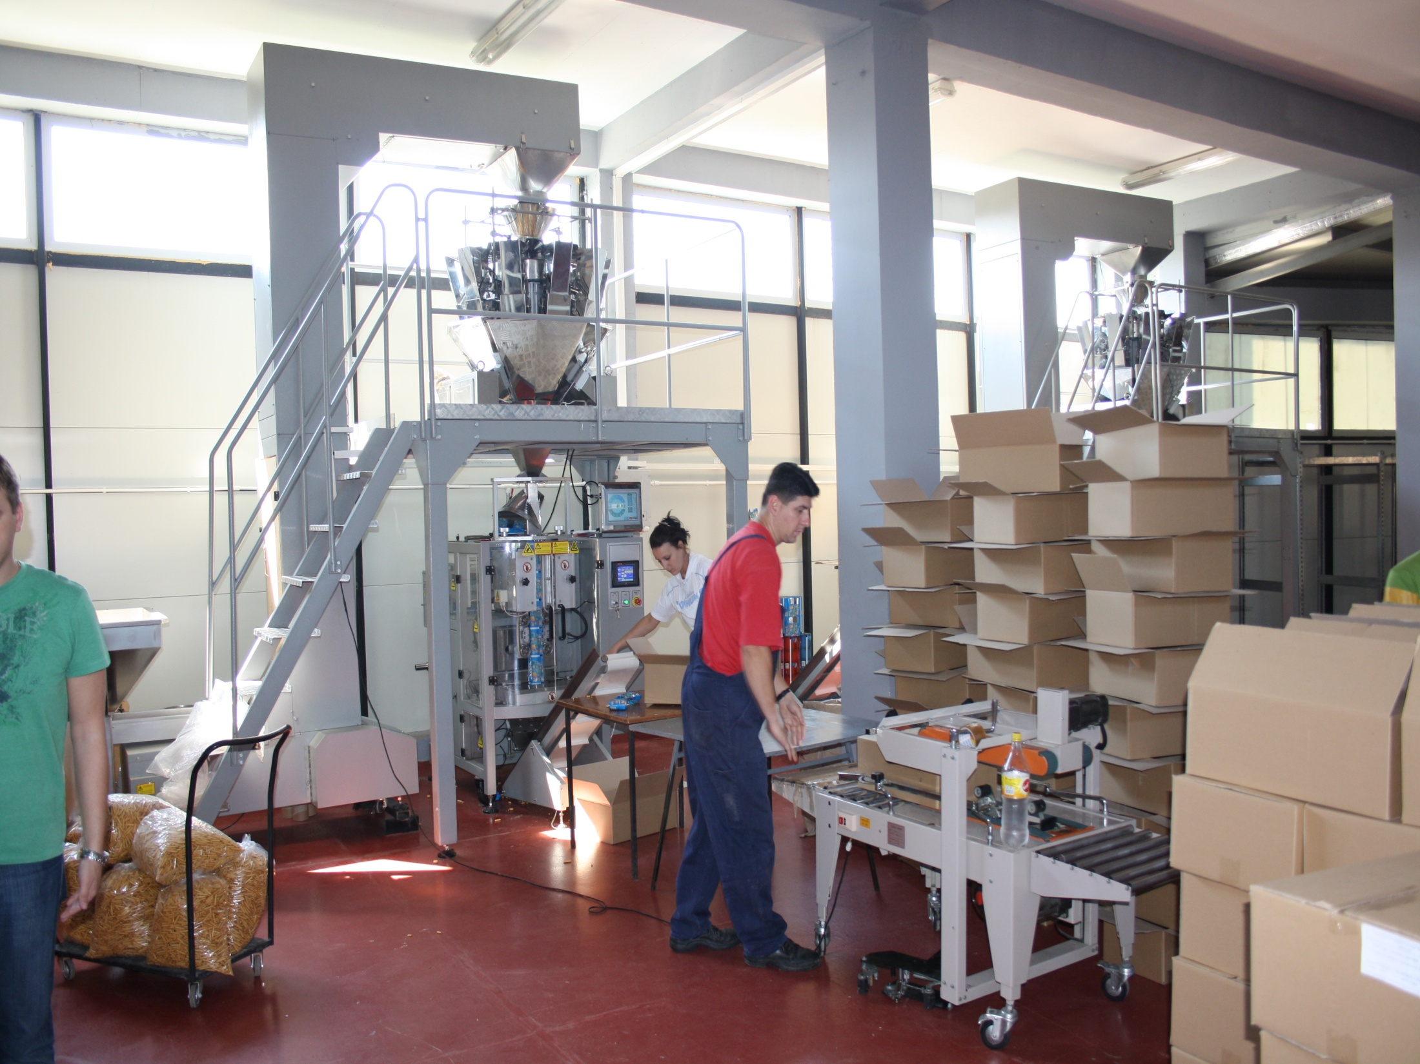

Slide 31
